Slide 1
Web Crawling
Based on the slides by Filippo Menczer @Indiana University School of Informatics in Web Data Mining by Bing Liu

Slide 2
Outline
Motivation and taxonomy of crawlers
Basic crawlers and implementation issues
Universal crawlers
Crawler ethics and conflicts

Slide 3
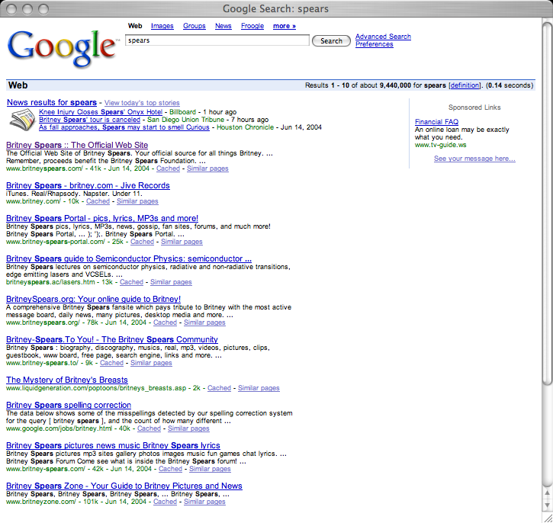
Q: How does a search engine know that all these pages contain the query terms?
A: Because all of those pages have been crawled

Slide 4

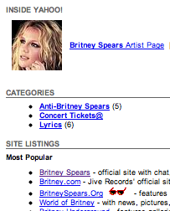
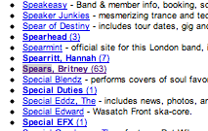
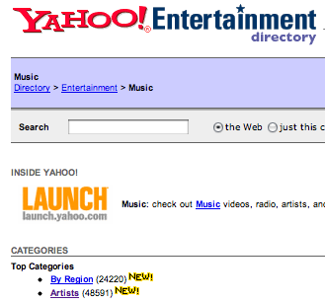
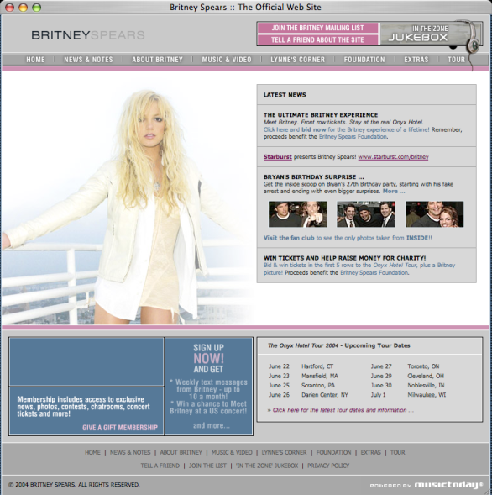
starting
pages
(seeds)
Crawler: basic idea

Slide 5
Many names
Crawler
Spider
Robot (or bot)
Web agent
Wanderer, worm, …
And famous instances: googlebot, scooter, slurp, msnbot, …

Slide 6
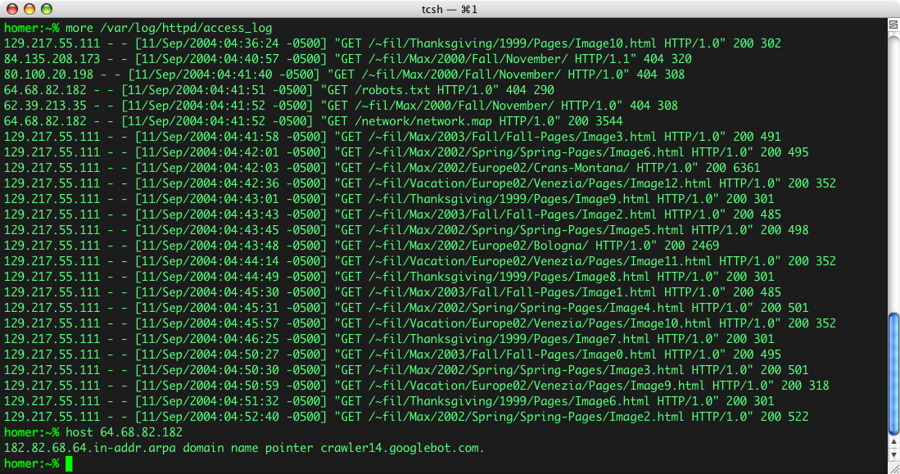
Googlebot & you

Slide 7
Motivation for crawlers
Support universal search engines (Google, Yahoo, MSN/Windows Live, Ask, etc.)
Vertical (specialized) search engines, e.g. news, shopping, papers, recipes, reviews, etc.
Business intelligence: keep track of potential competitors, partners
Monitor Web sites of interest
Evil: harvest emails for spamming, phishing…
… Can you think of some others?…

Slide 8
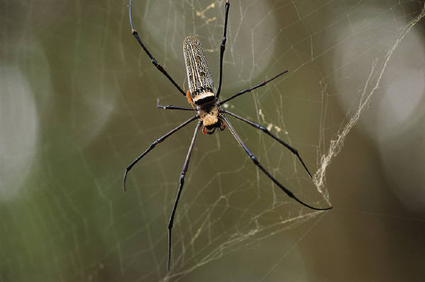
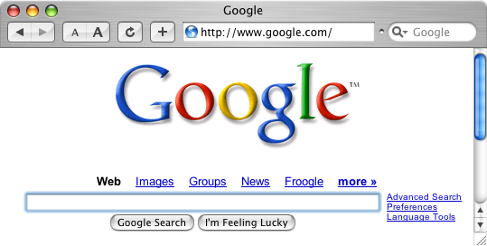
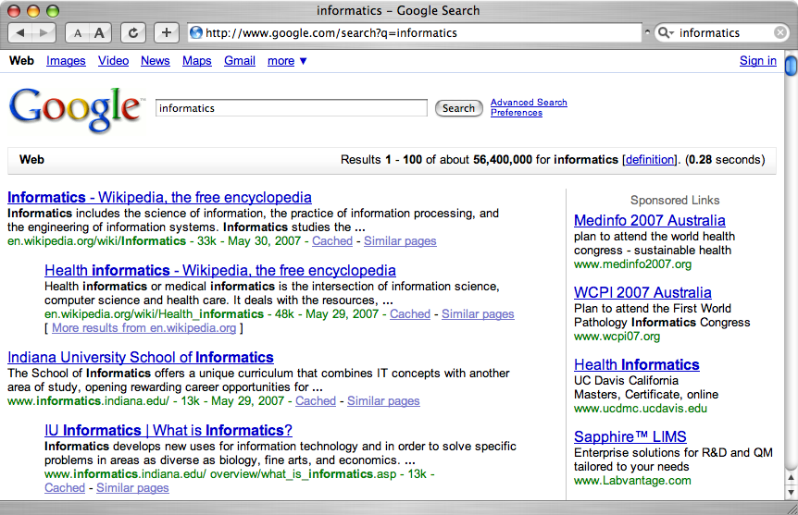
A crawler within a search engine
Web
Page repository
googlebot
Text & link analysis
Query
hits
Text index
PageRank
Ranker

Slide 9
One taxonomy of crawlers
Many other criteria could be used:
Incremental, Interactive, Concurrent, Etc.

Slide 10
Outline
Motivation and taxonomy of crawlers
Basic crawlers and implementation issues
Universal crawlers
Crawler ethics and conflicts

Slide 11
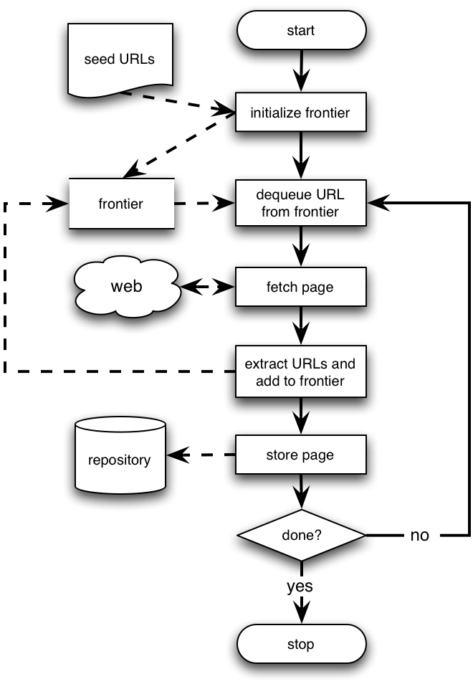
Basic crawlers
This is a sequential crawler
Seeds can be any list of starting URLs
Order of page visits is determined by frontier data structure
Stop criterion can be anything

Slide 12
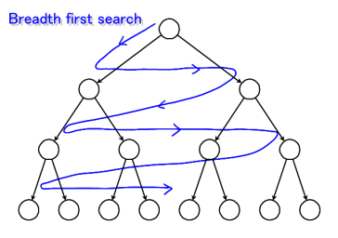
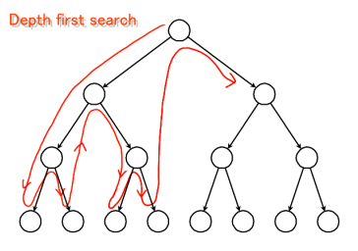
Graph traversal (BFS or DFS?)
Breadth First Search
Implemented with QUEUE (FIFO)
Finds pages along shortest paths
If we start with “good” pages, this keeps us close; maybe other good stuff…
Depth First Search
Implemented with STACK (LIFO)
Wander away (“lost in cyberspace”)

Slide 13
A basic crawler in Perl
Queue: a FIFO list (shift and push)
my @frontier = read_seeds($file);
while (@frontier && $tot < $max) {
my $next_link = shift @frontier;
my $page = fetch($next_link);
add_to_index($page);
my @links = extract_links($page, $next_link);
push @frontier, process(@links);
}
A workable example

Slide 14
Implementation issues
Don’t want to fetch same page twice!
Keep lookup table (hash) of visited pages
What if not visited but in frontier already?
The frontier grows very fast!
May need to prioritize for large crawls
Fetcher must be robust!
Don’t crash if download fails
Timeout mechanism
Determine file type to skip unwanted files
Can try using extensions, but not reliable
Can issue ‘HEAD’ HTTP commands to get Content-Type (MIME) headers, but overhead of extra Internet requests

Slide 15
More implementation issues
Fetching
Get only the first 10-100 KB per page
Take care to detect and break redirection loops
Soft fail for timeout, server not responding, file not found, and other errors

Slide 16
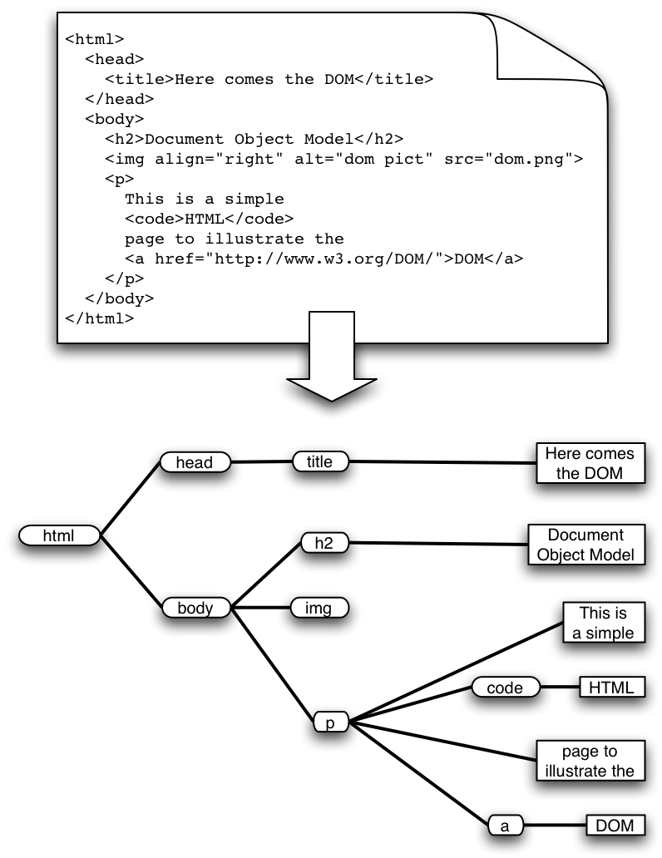
More implementation issues: Parsing
HTML has the structure of a DOM (Document Object Model) tree
Unfortunately actual HTML is often incorrect in a strict syntactic sense
Crawlers, like browsers, must be robust/forgiving
Fortunately there are tools that can help
E.g. tidy.sourceforge.net
Must pay attention to HTML entities and unicode in text
What to do with a growing number of other formats?
Flash, SVG, RSS, AJAX…

Slide 17
More implementation issues
Stop words
Noise words that do not carry meaning should be eliminated (“stopped”) before they are indexed
E.g. in English: AND, THE, A, AT, OR, ON, FOR, etc…
Typically syntactic markers
Typically the most common terms
Typically kept in a negative dictionary
10–1,000 elements
E.g. http://ir.dcs.gla.ac.uk/resources/linguistic_utils/stop_words
Parser can detect these right away and disregard them

Slide 18
More implementation issues
Conflation and thesauri
Idea: improve recall by merging words with same meaning
We want to ignore superficial morphological features, thus merge semantically similar tokens
{student, study, studying, studious} => studi
We can also conflate synonyms into a single form using a thesaurus
30-50% smaller index
Doing this in both pages and queries allows to retrieve pages about ‘automobile’ when user asks for ‘car’
Thesaurus can be implemented as a hash table

Slide 19
More implementation issues
Stemming
Morphological conflation based on rewrite rules
Language dependent!
Porter stemmer very popular for English
http://www.tartarus.org/~martin/PorterStemmer/
Context-sensitive grammar rules, eg:
“IES” except (“EIES” or “AIES”) --> “Y”
Versions in Perl, C, Java, Python, C#, Ruby, PHP, etc.
Porter has also developed Snowball, a language to create stemming algorithms in any language
http://snowball.tartarus.org/
Ex. Perl modules: Lingua::Stem and Lingua::Stem::Snowball

Slide 20
More implementation issues
Static vs. dynamic pages
Is it worth trying to eliminate dynamic pages and only index static pages?
Examples:
http://www.census.gov/cgi-bin/gazetteer
http://informatics.indiana.edu/research/colloquia.asp
http://www.amazon.com/exec/obidos/subst/home/home.html/002-8332429-6490452
http://www.imdb.com/Name?Menczer,+Erico
http://www.imdb.com/name/nm0578801/
Why or why not? How can we tell if a page is dynamic? What about ‘spider traps’?
What do Google and other search engines do?

Slide 21
More implementation issues
Relative vs. Absolute URLs
Crawler must translate relative URLs into absolute URLs
Need to obtain Base URL from HTTP header, or HTML Meta tag, or else current page path by default
Examples
Base: http://www.cnn.com/linkto/
Relative URL: intl.html
Absolute URL: http://www.cnn.com/linkto/intl.html
Relative URL: /US/
Absolute URL: http://www.cnn.com/US/

Slide 22
More implementation issues
URL canonicalization
All of these:
http://www.cnn.com/TECH
http://WWW.CNN.COM/TECH/
http://www.cnn.com:80/TECH/
http://www.cnn.com/bogus/../TECH/
Are really equivalent to this canonical form:
http://www.cnn.com/TECH/
In order to avoid duplication, the crawler must transform all URLs into canonical form
Definition of “canonical” is arbitrary, e.g.:
Could always include port
Or only include port when not default :80

Slide 23
More on Canonical URLs
Some transformation are trivial, for example:
http://informatics.indiana.edu
http://informatics.indiana.edu/
http://informatics.indiana.edu/index.html#fragment
http://informatics.indiana.edu/index.html
http://informatics.indiana.edu/dir1/./../dir2/
http://informatics.indiana.edu/dir2/
http://informatics.indiana.edu/%7Efil/
http://informatics.indiana.edu/~fil/
http://INFORMATICS.INDIANA.EDU/fil/
http://informatics.indiana.edu/fil/

Slide 24
More on Canonical URLs
Other transformations require heuristic assumption about the intentions of the author or configuration of the Web server:
Removing default file name
http://informatics.indiana.edu/fil/index.html
http://informatics.indiana.edu/fil/
This is reasonable in general but would be wrong in this case because the default happens to be ‘default.asp’ instead of ‘index.html’
Trailing directory
http://informatics.indiana.edu/fil
http://informatics.indiana.edu/fil/
This is correct in this case but how can we be sure in general that there isn’t a file named ‘fil’ in the root dir?

Slide 25
More implementation issues
Spider traps
Misleading sites: indefinite number of pages dynamically generated by CGI scripts
Paths of arbitrary depth created using soft directory links and path rewriting features in HTTP server
Only heuristic defensive measures:
Check URL length; assume spider trap above some threshold, for example 128 characters
Watch for sites with very large number of URLs
Eliminate URLs with non-textual data types
May disable crawling of dynamic pages, if can detect

Slide 26
More implementation issues
Page repository
Naïve: store each page as a separate file
Can map URL to unique filename using a hashing function, e.g. MD5
This generates a huge number of files, which is inefficient from the storage perspective
Better: combine many pages into a single large file, using some XML markup to separate and identify them
Must map URL to {filename, page_id}
Database options
Any RDBMS -- large overhead
Light-weight, embedded databases such as Berkeley DB

Slide 27
Concurrency
A crawler incurs several delays:
Resolving the host name in the URL to an IP address using DNS
Connecting a socket to the server and sending the request
Receiving the requested page in response
Solution: Overlap the above delays by fetching many pages concurrently

Slide 28
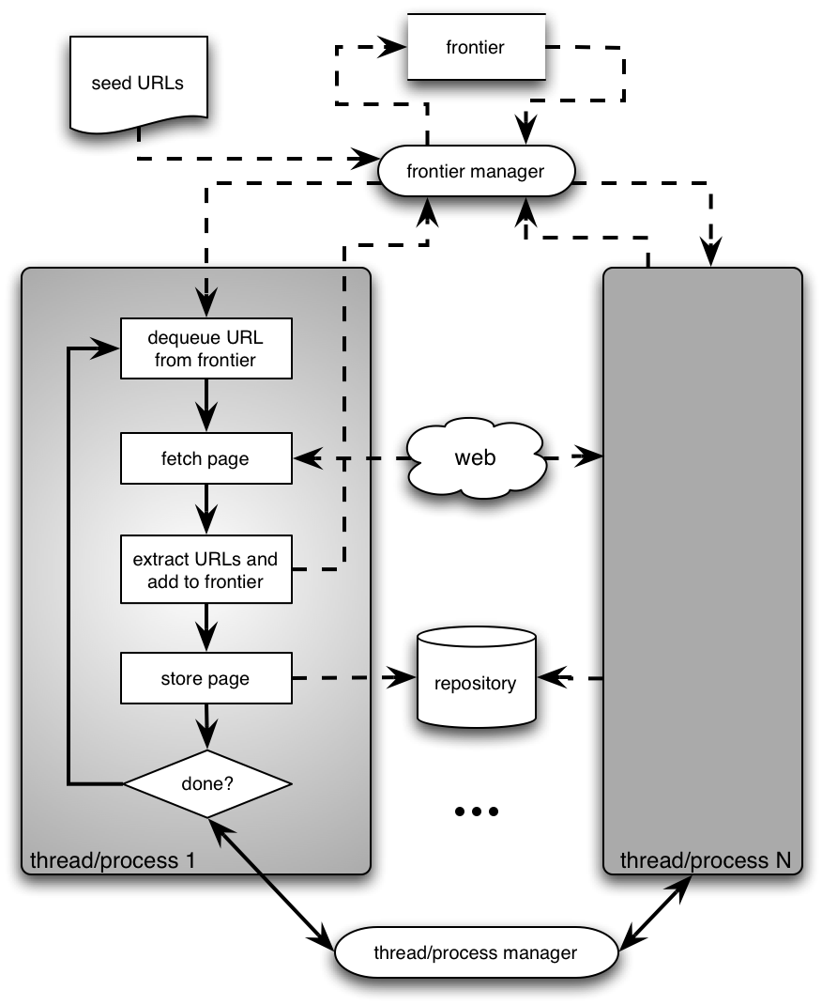
Architecture of a concurrent crawler

Slide 29
Concurrent crawlers
Can use multi-processing or multi-threading
Each process or thread works like a sequential crawler, except they share data structures: frontier and repository
Shared data structures must be synchronized (locked for concurrent writes)
Speedup of factor of 5-10 are easy this way

Slide 30
Outline
Motivation and taxonomy of crawlers
Basic crawlers and implementation issues
Universal crawlers
Crawler ethics and conflicts

Slide 31
Universal crawlers
Support universal search engines
Large-scale
Huge cost (network bandwidth) of crawl is amortized over many queries from users
Incremental updates to existing index and other data repositories

Slide 32
Large-scale universal crawlers
Two major issues:
Performance
Need to scale up to billions of pages
Policy
Need to trade-off coverage, freshness, and bias (e.g. toward “important” pages)

Slide 33
Large-scale crawlers: scalability
Need to minimize overhead of DNS lookups
Need to optimize utilization of network bandwidth and disk throughput (I/O is bottleneck)
Use asynchronous sockets
Multi-processing or multi-threading do not scale up to billions of pages
Non-blocking: hundreds of network connections open simultaneously
Polling socket to monitor completion of network transfers

Slide 34
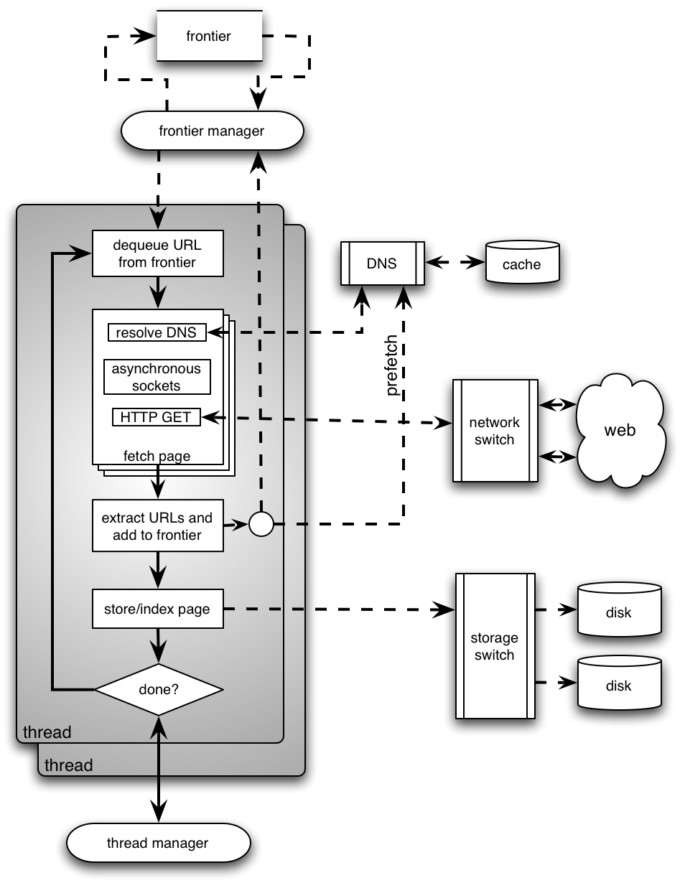
High-level architecture of a scalable universal crawler
Several parallel queues to spread load across servers (keep connections alive)
DNS server using UDP (less overhead than TCP), large persistent in-memory cache, and prefetching
Optimize use of network bandwidth
Huge farm of crawl machines
Optimize disk I/O throughput

Slide 35
Universal crawlers: Policy
Coverage
New pages get added all the time
Can the crawler find every page?
Freshness
Pages change over time, get removed, etc.
How frequently can a crawler revisit ?
Trade-off!
Focus on most “important” pages (crawler bias)?
“Importance” is subjective

Slide 36
Web coverage by search engine crawlers
This assumes we know the size of the entire the Web. Do we? Can you define “the size of the Web”?

Slide 37
Maintaining a “fresh” collection
Universal crawlers are never “done”
High variance in rate and amount of page changes
HTTP headers are notoriously unreliable
Last-modified
Expires
Solution
Estimate the probability that a previously visited page has changed in the meanwhile
Prioritize by this probability estimate

Slide 38
Estimating page change rates
Algorithms for maintaining a crawl in which most pages are fresher than a specified epoch
Brewington & Cybenko; Cho, Garcia-Molina & Page
Assumption: recent past predicts the future (Ntoulas, Cho & Olston 2004)
Frequency of change not a good predictor
Degree of change is a better predictor

Slide 39
Do we need to crawl the entire Web?
If we cover too much, it will get stale
There is an abundance of pages in the Web
For PageRank, pages with very low prestige are largely useless
What is the goal?
General search engines: pages with high prestige
News portals: pages that change often
Vertical portals: pages on some topic
What are appropriate priority measures in these cases? Approximations?

Slide 40
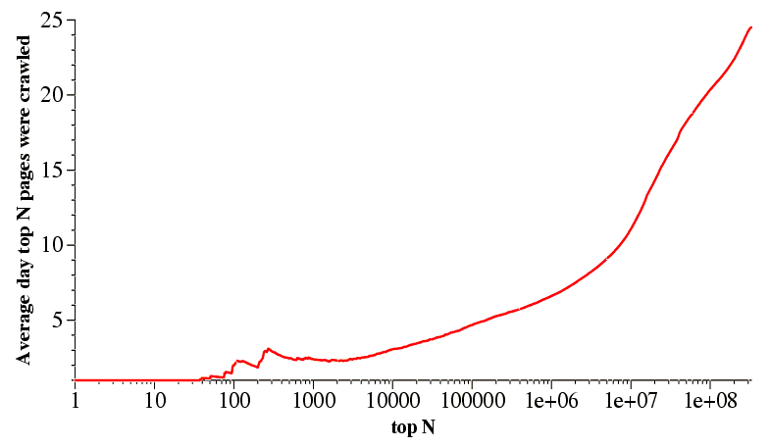
Breadth-first crawlers
BF crawler tends to crawl high-PageRank pages very early
Therefore, BF crawler is a good baseline to gauge other crawlers
But why is this so?
Najork and Weiner 2001

Slide 41
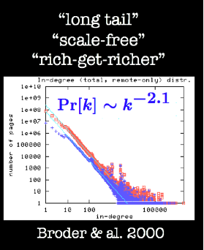
Bias of breadth-first crawlers
The structure of the Web graph is very different from a random network
Power-law distribution of in-degree
Therefore there are hub pages with very high PR and many incoming links
These are attractors: you cannot avoid them!

Slide 42
Outline
Motivation and taxonomy of crawlers
Basic crawlers and implementation issues
Universal crawlers
Crawler ethics and conflicts

Slide 43
Crawler ethics and conflicts
Crawlers can cause trouble, even unwillingly, if not properly designed to be “polite” and “ethical”
For example, sending too many requests in rapid succession to a single server can amount to a Denial of Service (DoS) attack!
Server administrator and users will be upset
Crawler developer/admin IP address may be blacklisted

Slide 44
Crawler etiquette (important!)
Identify yourself
Use ‘User-Agent’ HTTP header to identify crawler, website with description of crawler and contact information for crawler developer
Use ‘From’ HTTP header to specify crawler developer email
Do not disguise crawler as a browser by using their ‘User-Agent’ string
Always check that HTTP requests are successful, and in case of error, use HTTP error code to determine and immediately address problem
Pay attention to anything that may lead to too many requests to any one server, even unwillingly, e.g.:
redirection loops
spider traps

Slide 45
Crawler etiquette (important!)
Spread the load, do not overwhelm a server
Make sure that no more than some max. number of requests to any single server per unit time, say < 1/second
Honor the Robot Exclusion Protocol
A server can specify which parts of its document tree any crawler is or is not allowed to crawl by a file named ‘robots.txt’ placed in the HTTP root directory, e.g. http://www.indiana.edu/robots.txt
Crawler should always check, parse, and obey this file before sending any requests to a server
More info at:
http://www.google.com/robots.txt
http://www.robotstxt.org/wc/exclusion.html

Slide 46
More on robot exclusion
Make sure URLs are canonical before checking against robots.txt
Avoid fetching robots.txt for each request to a server by caching its policy as relevant to this crawler
Let’s look at some examples to understand the protocol…

Slide 47
www.apple.com/robots.txt
# robots.txt for http://www.apple.com/
User-agent: *
Disallow:
All crawlers…
…can go anywhere!

Slide 48
www.microsoft.com/robots.txt
# Robots.txt file for http://www.microsoft.com
User-agent: *
Disallow: /canada/Library/mnp/2/aspx/
Disallow: /communities/bin.aspx
Disallow: /communities/eventdetails.mspx
Disallow: /communities/blogs/PortalResults.mspx
Disallow: /communities/rss.aspx
Disallow: /downloads/Browse.aspx
Disallow: /downloads/info.aspx
Disallow: /france/formation/centres/planning.asp
Disallow: /france/mnp_utility.mspx
Disallow: /germany/library/images/mnp/
Disallow: /germany/mnp_utility.mspx
Disallow: /ie/ie40/
Disallow: /info/customerror.htm
Disallow: /info/smart404.asp
Disallow: /intlkb/
Disallow: /isapi/
#etc…
All crawlers…
…are not allowed in these paths…

Slide 49
www.springer.com/robots.txt
# Robots.txt for http://www.springer.com (fragment)
User-agent: Googlebot
Disallow: /chl/*
Disallow: /uk/*
Disallow: /italy/*
Disallow: /france/*
User-agent: slurp
Disallow:
Crawl-delay: 2
User-agent: MSNBot
Disallow:
Crawl-delay: 2
User-agent: scooter
Disallow:
# all others
User-agent: *
Disallow: /
Google crawler is allowed everywhere except these paths
Yahoo and MSN/Windows Live are allowed everywhere but should slow down
AltaVista has no limits
Everyone else keep off!

Slide 50
More crawler ethics issues
Is compliance with robot exclusion a matter of law?
No! Compliance is voluntary, but if you do not comply, you may be blocked
Someone (unsuccessfully) sued Internet Archive over a robots.txt related issue
Some crawlers disguise themselves
Using false User-Agent
Randomizing access frequency to look like a human/browser
Example: click fraud for ads

Slide 51
More crawler ethics issues
Servers can disguise themselves, too
Cloaking: present different content based on User-Agent
E.g. stuff keywords on version of page shown to search engine crawler
Search engines do not look kindly on this type of “spamdexing” and remove from their index sites that perform such abuse
Case of bmw.de made the news

Slide 52
Gray areas for crawler ethics
If you write a crawler that unwillingly follows links to ads, are you just being careless, or are you violating terms of service, or are you violating the law by defrauding advertisers?
Is non-compliance with Google’s robots.txt in this case equivalent to click fraud?
If you write a browser extension that performs some useful service, should you comply with robot exclusion?

